Slide 1
PAUSE Wimauma Growth

Slide 2
Wimauma Community Planning Advisory Council (WCPAC)
Wimauma volunteer residents with a goal to guide Wimauma’s growth in line with the Wimauma Village Plan
WCPAC does not make development decisions but instead coordinates with developers and County Commissioners encouraging Wimauma Community Benefits
Transportation Improvements
Affordable Housing
Cultural and Historic Preservation
Land set aside for Schools, Child Care, Parks. Walking Trails, agriculture, green space, etc.
Encourage Commercial Development providing local jobs
Support Bethune Park Revitalization
Email: Wimauma.cpac@gmail.com

Slide 3
PAUSE Wimauma Growth
Hillsborough County - Board of County Commissioners (BOCC)
On January 9, 2025 voted to approve 4 Urban Service Area (USA) Extension Applications
Each application had a text and map change resulting in 8 votes on 4 developments
All applications changed Wimauma Village Resident – 2 (WVR-2) to Resident – 4 (RES – 4)
Doubles the number of houses from 2 per acre average to 4 per acre average
No Infrastructure Study prior to vote to approve applications
Road impact
School Impact (County planning factor is 1.34 children per house enrolled in K-12)
Flooding Impact
Environment has changed from the 1990s flood mitigation requirements
WVR-2 to Res-4 eliminates community benefit requirement under WVR-2
Multi-Use Trail(s)
Community Park with recreational uses
Affordable Housing
Public School Site (minimum of 14 acres)
Neighborhood Community Center (Civic Space)
No Commercial Development planned to provide local jobs

Slide 4
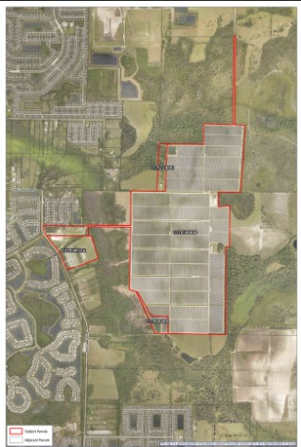
PAUSE Wimauma Growth
West Lake
19th Street Extension

Slide 5
PAUSE Wimauma Growth
Wimauma Service Area Extension Development 1
HC/CPA 24-11 – Text Amendment
HC/CPA 24-10 – Map Amendment
Location: 15540 West Lake Drive
Quarter of a mile South of Bill Tucker on West Lake, 2 miles North of Route 674, and on West Lake opposite 19th Street future extension between Valencia Lakes and Valencia Del Sol.
Changed: 551.24 acres from Wimauma Village Residential-2 (WVR-2) to Residential-4 (RES-4)
Owner requesting zoning change stating not planning to develop
Impacts for new owner when developed:
2,205 New houses (4 per acre)
No planned elementary school for 2,955 additional children (1.34 per house)
4,410 additional cars based on 2 per house
Impacts West Lake, Bill Tucker, Route 674 and 19th Street extension
WVR-2 to Res-4 eliminates community benefit requirement under WVR-2

Slide 6
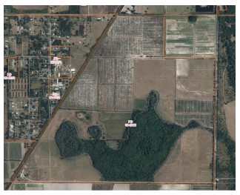
PAUSE Wimauma Growth
Bishop Road
Bishop Rd
Saffold Rd

Slide 7
PAUSE Wimauma Growth
Wimauma Service Area Extension Development 2
HC/CPA 24-07 – Text Amendment
HC/CPA 23-19 – Map Amendment
Location: 5711 Bishop Rd
3 miles South of Route 674 between Route 301 and W Lake Drive
Changed: 408.26 acres from Wimauma Village Residential-2 (WVR-2) to Residential-4 (RES-4)
Impacts:
1,633 New houses (4 per acre)
No planned elementary school for 2,188 additional children (1.34 per house)
3,266 additional cars based on 2 per house
Impacts Bishop Rd and route 301 with no road planned improvements
WVR-2 to Res-4 eliminates community benefit requirement under WVR-2

Slide 8
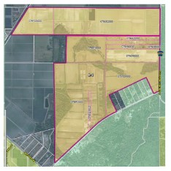
PAUSE Wimauma Growth
Safford Road
579
Saffold

Slide 9
PAUSE Wimauma Growth
Wimauma Service Area Extension Development 3
HC/CPA 24-09 – Text Amendment
HC/CPA 24-08 – Map Amendment
Location: Saffold Road and CR 579
5 ½ miles South of Route 674 between Route 301 and County Road 579
Changed: 638.77 acres from Wimauma Village Residental-2 (WVR-2) to Residental-4 (RES-4)
Impacts:
2,555 New houses (4 per acre)
Known area for flooding
Flooding studies being requested – results after application approval
No planned elementary school for 3,424 additional children (1.34 per house)
5,110 additional cars based on 2 per house
Impacts Saffold Rd, West Lake, County Road 579 and route 301
No comprehensive road impact study beyond Safford
WVR-2 to Res-4 eliminates community benefit requirement under WVR-2

Slide 10
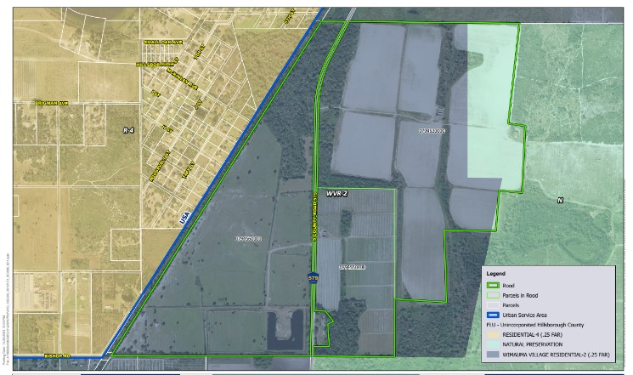
PAUSE Wimauma Growth
North Bishop Road
WEST - LAKE
579
North - Bishop

Slide 11
PAUSE Wimauma Growth
Wimauma Service Area Extension Development 4
HC/CPA 24-13 – Text Amendment
HC/CPA 24-12 – Map Amendment
Location: North Bishop road and CR 579
3 miles South of Route 674 between Route 301 and CR 579 crossing over West Lake
Changed: 505.01 acres from Wimauma Village Residential-2 (WVR-2) to Residential-4 (RES-4)
Impacts:
2,020 New houses (4 per acre)
Known for flooding
Flooding studies being requested – results after application approval
No planned elementary school for 2,707 additional children (1.34 per house)
4,040 additional cars based on 2 per house
Impacts Bishop Rd, Route 301 and West Lake
WVR-2 to Res-4 eliminates community benefit requirement under WVR-2

Slide 12
PAUSE Wimauma Growth
Cumulative Impact of Just 4 Wimauma Service Area Extension Applications
Changed: 2,103.28 acres from Wimauma Village Residental-2 (WVR-2) to Residental-4 (RES-4)
Impacts:
8,413 New houses (4 per acre)
No planned schools for 11,826 additional children (1.34 per house)
Approved these applications prior to building new schools - result in overcrowding
16,826 additional cars based on 2 per house
County does not plan on cumulative developments – only plan for application development only
No Commercial Development providing local jobs for Wimauma Residents
WVR-2 to Res-4 eliminates community benefit requirement under WVR-2
Multi-use Trail(s)
Community Park with recreational uses
Land for Child Care
Affordable Housing
Non-Charter Public School Site (minimum of 14 acres)
Neighborhood Community Center (Civic Space)
Wimauma has experienced Flooding in the past few years
Flood requirement mitigation is based on 1990 studies – over 30 year’s old
Approving new development in known flood area does not make sense
Comprehensive flood study needed with updated mitigation requirements for developers

Slide 13
PAUSE Wimauma Growth
Pause Wimauma New Development for a
Comprehensive Infrastructure Study
Road and traffic study from increased vehicle trips and storm impacts
Regional plan for handling increased traffic on Wimauma new and existing Roads
Determine the new schools necessary for increased child population
Plan schools and build in time for new housing development
Flooding Risks
Ongoing approved developments are contributing to increased flooding in 2024 from
Tropical Storm Debby
Hurricane Milton
Areas in Wimauma designated as “Low Risk” are now vulnerable to flooding without mitigation
Caused by changes in land use and drainage patterns
Pause New Development necessary to perform a comprehensive Infrastructure and Hydrology Study
Analyze flood patterns
Assess Road network to handle increased traffic and storm impacts
Evaluate Storm Water Management for future storms of increasing frequency and intensity

Slide 14
PAUSE Wimauma Growth
Wimauma Service Area Extension
(Staff Recommendation)
HC/CPA 24-44 Text Amendment
HC/CPA 24-45 Map Amendment
On February 24, 2025, the Planning Commission voted (5-2) against the Staff Recommended Urban Service Area Extension and recommended that further studies be conducted.
On March 13, 2025, BOCC voted initial approval of the Staff Recommended Urban Service Area Extension
Final vote of the BOCC is expected on June 12, 2025
Location: South of CR672, east of 301, and west of CR39
Changed: 5661.17 acres from Wimauma Village Residential (WVR-2) to Residential 4 (RES-4)
Impact: 16, 832 New homes (4 per acre)

Slide 15
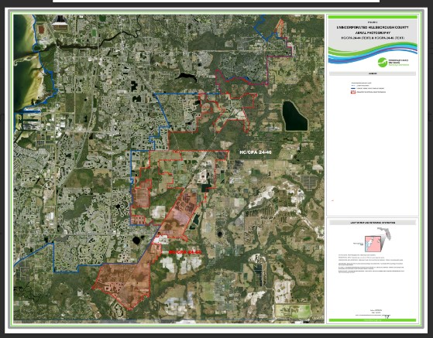
Staff Recommended USA Expansion

Slide 16
PAUSE Wimauma Growth
WCPAC Wins
The Planning Commission has awarded a contract to study Little Manatee South area and I4 Corridor before any further consideration of expanding the Urban Service Area.
County Commissioners are discussing guaranteeing that all Developer Impact Fees from USA developments be spent in Wimauma.
County Departments must amend their Urban Service Area Reports before June 12, 2025, Public Hearing.
PAUSE Change,org petition was signed by over 1800 people. Hundreds of Wimauma residents and other South County residents have written to the County Commissioners.
The Planning Commissioner voted 5-2 against the USA reclassification and requested more studies be conducted.

Slide 17
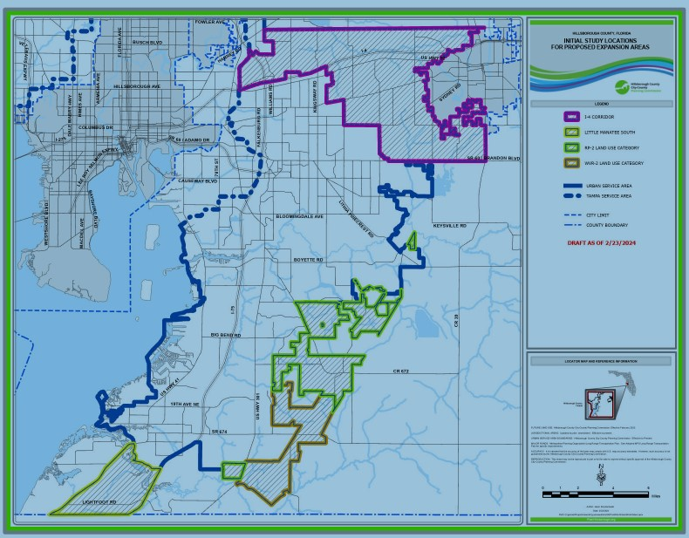
PAUSE Wimauma Growth

Slide 18
To Request a copy of these slides send email to:
Wimauma.CPAC@gmail.com
Subject: Request WCPAC Slides
Provide: Name, phone, and email

